Slide 1

cv
Efficient Algorithmic models for Adversarial attacks and Defenses in Deep learning
Phase II – Final Review
Team Members
Durgesh Nandini M [1DS19CS711]
Gaurav Sarkar [1DS19CS715]
3. Gagandeep B K [1DS19CS714]
4. Faizan Khurshid [1DS19CS713]
Under the Guidance of
Prof Sarala DV,
Assistant Professor,
Dept of Computer Science and Engineering
Department of Computer Science & Engineering, DSCE

Slide 2
Table of Contents
Sl.No | Contents
1 | Introduction
2 | Objectives
3 | Literature Survey
4 | System Architecture
5 | Implementation
6 | Conclusion
7 | References
Department of Computer Science & Engineering, DSCE

Slide 3
Introduction
There is rapid development in artificial intelligence (AI) and deep learning (DL) techniques and hence it is very critical to ensure the security and robustness of the deployed algorithms.
Adversarial attacks are crafted malicious inputs(image, text, and voice) that are fed to the machine learning models in order to cause them make a mistake, a misclassification or a wrong prediction.
Adversaries can easily fool DL models by perturbing benign samples without being discovered by humans.
Perturbations that are imperceptible to human vision/hearing are sufficient to prompt the model to make a wrong prediction with high confidence.
Thus adversarial sample is considered to be a significant obstacle to the mass deployment of DL models that are in production.
Therefore there are a number of attack algorithms for generating adversarial samples, and a number of defense mechanisms for providing protection against adversarial attacks and making the models more robust and secure.
Department of Computer Science & Engineering, DSCE

Slide 4
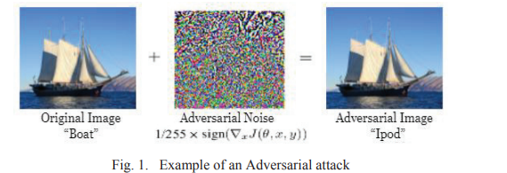
Example
In the above example we have lightly modified the original input image by adding adversarial perturbations in such a way that these alterations are almost unnoticeable to the human eye but leads to misclassification of the images.
Initially the model predicted the image as “Boat”, but when adversarial perturbations are introduced, it predicts the same image as “Ipod”
Department of Computer Science & Engineering, DSCE
Department of Computer Science & Engineering, DSCE

Slide 5
Objectives
We are aiming to demonstrate different types of adversarial attacks on the image data model
We are aiming to demonstrate different types of defense mechanisms on the image data model to provide protection against adversarial attacks and thereby make the models more robust and secure
We are aiming to demonstrate different types of adversarial attacks on the text data model
We are aiming to demonstrate different types of defense mechanisms on the text data model to provide protection against adversarial attacks and thereby make the models more robust and secure
We are also aiming to perform a comparative analysis of the adversarial attack algorithms and defense strategies
Department of Computer Science & Engineering, DSCE

Slide 6
cv
Literature Survey Tabulation :
SI NO | Research Paper Name | Author Name | Algorithms and Methodologies | Datasets | Objectives
1 | Adversarial Attacks Technology in Deep Learning Models | Yucong Lai, Yifeng Wang | Fast Gradient Sign Method, Basic iteration method, HotFlip, BERT | SNLI dataset, MultiNLI dataset, Imagenet Dataset | The current development of neural network and adversarial example technologies in the image and text
2 | Adversarial Attacks for the Deep Learning model using Efficient Gradient Integrated Attacking algorithm. | Muttoni | Fast Gradient Method, Basic iterative method, Diverse inputs method | CIFAR-10 Dataset, Imagenet Dataset | Efficient Gradient Integrated change is used to increase the loss function in the designed model and this can be adopted to every gradient algorithm method which increases the loss function. The attack's efficiency is increased by adding the gradients for every two iterations.
Department of Computer Science & Engineering, DSCE

Slide 7
cv
SI NO | Research Paper Name | Author Name | Algorithms and Methodologies | Datasets | Objectives
3 | Adversarial attacks on deep learning models in smart grids | Jingbo Hao, Yang Tao | Adversarial evasion attacks, Adversarial poisoning attacks, Gradient masking, Auxiliary detection, Preprocessing techniques, Proximity measurements and Ensemble of classifiers | MNIST dataset | Adversarial evasion and poisoning attacks in smart grids are analyzed and exemplified respectively with emphasis. Typical countermeasures against these adversarial attacks are also presented.
4 | Adversarial attack and defense methods for neural network based state estimation in smart grid | Tian, Jiwei; Wang, Buhong; Li, Jing; Konstantinou, Charalambos | Forward derivative-based adversarial attack, Random scaling attack, Protection-based defense method, Adversarial training-based defense method | Plug-Load Appliance Identification Dataset (PLAID) | Forward derivative-based method of attack and Random scaling attack are proposed and to counter the threat two defense mechanisms are also provided. Both defense methods can improve the ability of the Neural Network(NN) model to defend against adversarial attacks .
Department of Computer Science & Engineering, DSCE

Slide 8
cv
SI NO | Research Paper Name | Author Name | Algorithms and Methodologies | Objectives
5 | Adversarial Attacks and Defenses: An Interpretation Perspect | Ninghao Liu, Mengnan Du, Ruocheng Guo, Huan Liu, Xia Hu | Feature-Level Interpretation for Understanding Adversarial Attacks: 1)Gradient-Based Techniques: a)Improved Gradient-Based Techniques b)Region-Based SURNAMEA, SURNAMEB AND SURNAMEC et al. Exploration c)Path-Based Integration 2)Distillation-Based Techniques: 3)Influence-Function Based Techniques Feature-Level Interpretation for Adversarial Defenses: 1)Model Robustification With Feature-Level Interpretation: 2)Adversarial Detection With Feature-Level Interpretation: Model-level Interpretation IN a dversarial machine learning: 1)Model Component Interpretation for Understanding Adversarial Attacks: 2)Representation Interpretation for Initiating Adversarial Attacks: Model-Level Interpretation for Adversarial Defenses: | Model-level interpretation and feature-level interpretation are the two categories under which interpretation is classified. We go into more detail on how each type of interpretation can be applied to aggressive assaults and defenses. Then, we present a few other connections between interpretation and adversaries
Department of Computer Science & Engineering, DSCE

Slide 9
cv
SI NO | Research Paper Name | Author Name | Algorithms and Methodologies | Datasets | Objectives
6 | Targeted Mismatch Adversarial Attack: Query with a Flower to Retrieve the Tower | Giorgos Tolias, Filip Radenovic, Ondˇrej Chum | We introduce the idea of a targeted mismatch attack for retrieval systems based on deep learning, which creates an adversarial image to cover the query image |  | To substitute a target image for an adversarial one in a (concealed) query for image retrieval, the adversary attempts to create an adversarial image. Without revealing any data about the target image, itself, the aim is to get the same retrieval results
7 | Robust Text CAPTCHAs Using Adversarial Examples | Rulin Shao, Zhouxing Shi, Jinfeng Yi, Pin-Yu Chen, ChoJui Hsi | we present Robust Text CAPTCHA, a simple method for creating text-based CAPTCHAs (RTC). The first phase involves creating the foregrounds and backdrops using randomly sampled font and background images, which are then combined to make recognizable pseudo adversarial CAPTCHAs |  | For adversarial text CAPTCHA generation in the assault stage, we suggest the scaled Gaussian translation with channel shifts attack (SGTCS). We use three methods—weighted spatial translation, image scaling, and channel shifts—to improve the transferability of adversarial cases.
Department of Computer Science & Engineering, DSCE

Slide 10
cv
SI NO | Research Paper Name | Author Name | Algorithms and Methodologies | Datasets | Objectives
8 | Data Poisoning Attacks on Regression Learning and Corresponding Defenses | Nicolas Muller, Daniel Kowatsch, Konstantin Bottinger | We plan to analyze every facet of data tainting attacks on regression learning, going beyond prior research |  | Algorithm 1 Flip attack Algorithm 2 Trim defense Algorithm 3 iTrim defense
9 | A Word is Worth A Thousand Dollars: Adversarial Attack on Tweets Fools Stock Prediction | Yong Xie, Dakuo Wang, Pin-Yu Chen, Jinjun Xiong, Sijia Liu,and Sanmi Koyejo1 | Using a variety of adversarial assault situations, we examine three stock prediction victim models in this study. To complete the task of adversary creation, we address combinatorial optimization problems with semantics and financial constraints |  | Attack model: Adversarial tweets. In the case of Twitter, adversaries can post malicious tweets which are crafted to manipulate downstream models that take them as input. Attack generation: Hierarchical perturbation. The challenge of our attack method centers around how to select the optimal tweets and the token perturbations with the constraints of semantic similarity.
Department of Computer Science & Engineering, DSCE

Slide 11
cv
SI NO | Research Paper Name | Author Name | Algorithms and Methodologies | Objectives
10 | Audio Adversarial Examples: Targeted Attacks on Speech-to-Text | Nicholas Carlini, David Wagner | Introduction: For automatic speech recognition, we build tailored audio adversarial sample | Threat Model for methodology - Given an audio waveform x and a target transcription y, our job is to create an additional audio waveform x 0 = x + that is identical to x while also ensuring that C (x 0) = y. This task is described below. Only when the network’s output exactly matches the intended phrase— that is, without any misspellings or additional characters—do we declare a success.
Department of Computer Science & Engineering, DSCE

Slide 12
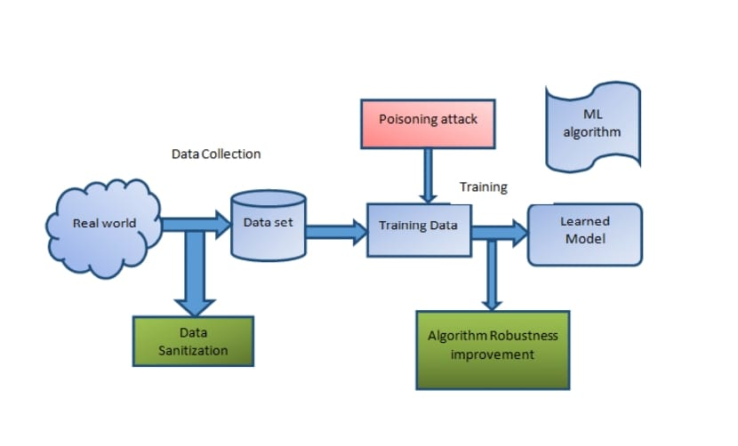
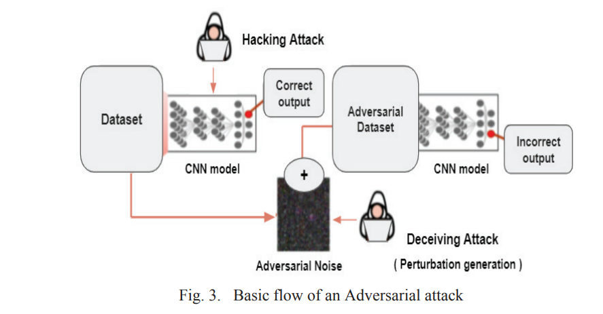
System Design/Architecture
Example
SYSTEM DIAGRAM / DESIGN :
Adversarial attacks on DL model
In the above example we have lightly modified the original input image by adding adversarial perturbations in such a way that these alterations are almost unnoticeable to the human eye but leads to misclassification of the images.
Initially the model predicted the image as “Boat”, but when adversarial perturbations are introduced, it predicts the same image as “Ipod”
Department of Computer Science & Engineering, DSCE
Department of Computer Science & Engineering, DSCE
Department of Computer Science & Engineering, DSCE

Slide 13
When the model is trained on a clean dataset, correct output is obtained. But when adversarial noise is added to clean the dataset, adversarial dataset is obtained, and when the model is trained on this adversarial dataset, incorrect output will be obtained
The model built is usually trained with a clean sample of images. Initially, the model detects the images correctly with a decent accuracy but when adversarial noise is injected into the original image dataset, the model predicts the incorrect result.
Due to the adversarial attack, the model starts predicting the original input image as an image of a different class other than its original class thus leading to the image misclassification and giving rise to a new set of adversarial images.
Example
SYSTEM DIAGRAM / DESIGN :
In the above example we have lightly modified the original input image by adding adversarial perturbations in such a way that these alterations are almost unnoticeable to the human eye but leads to misclassification of the images.
Initially the model predicted the image as “Boat”, but when adversarial perturbations are introduced, it predicts the same image as “Ipod”
Department of Computer Science & Engineering, DSCE
Department of Computer Science & Engineering, DSCE
Department of Computer Science & Engineering, DSCE

Slide 14
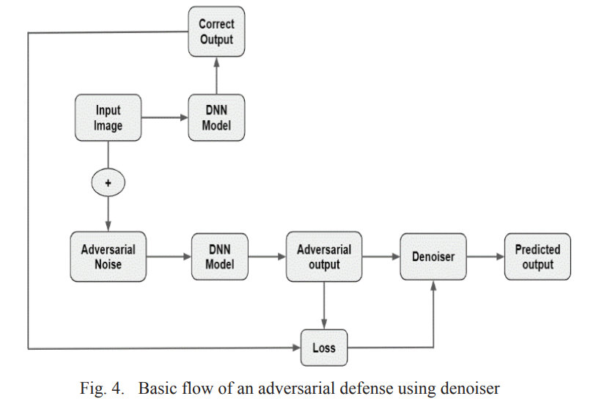
Defense mechanisms on DL model
Example
SYSTEM DIAGRAM / DESIGN :
In the above example we have lightly modified the original input image by adding adversarial perturbations in such a way that these alterations are almost unnoticeable to the human eye but leads to misclassification of the images.
Initially the model predicted the image as “Boat”, but when adversarial perturbations are introduced, it predicts the same image as “Ipod”
Department of Computer Science & Engineering, DSCE
Department of Computer Science & Engineering, DSCE
Department of Computer Science & Engineering, DSCE

Slide 15
The adversarial examples are obtained when the noise is added to the original input images. So, a general idea of defense that strikes is to denoise the adversarial examples to get back the proper prediction of the original images, wherein the adversaries can be removed with the help of a denoiser.
Here, the loss function can be defined as the variance between the correct output and the adversarial output.
Based on the difference in the loss function, the denoiser anticipates the output generally called as the predicted output.
If the correct output and the predicted output are nearly equal, then it can be said that defense against the adversaries is successfully accomplished.
Thus, it provides a general idea about the defense phase.
Example
SYSTEM DIAGRAM / DESIGN :
In the above example we have lightly modified the original input image by adding adversarial perturbations in such a way that these alterations are almost unnoticeable to the human eye but leads to misclassification of the images.
Initially the model predicted the image as “Boat”, but when adversarial perturbations are introduced, it predicts the same image as “Ipod”
Department of Computer Science & Engineering, DSCE
Department of Computer Science & Engineering, DSCE
Department of Computer Science & Engineering, DSCE

Slide 16
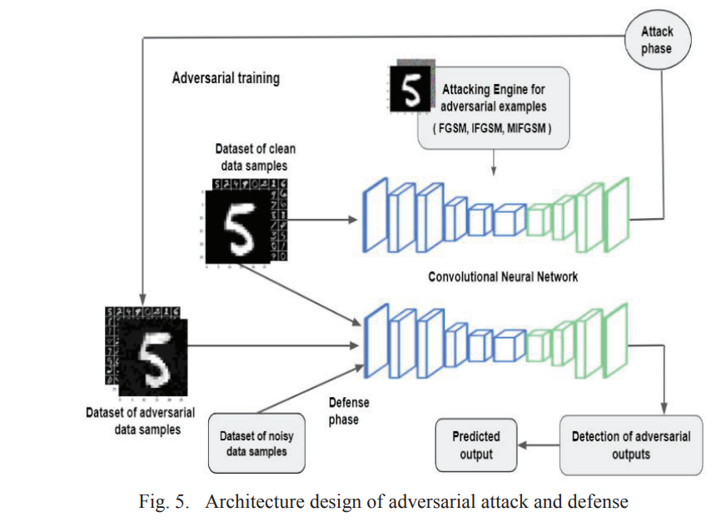
Architecture of adversarial attack and defense
Example
SYSTEM DIAGRAM / DESIGN :
In the above example we have lightly modified the original input image by adding adversarial perturbations in such a way that these alterations are almost unnoticeable to the human eye but leads to misclassification of the images.
Initially the model predicted the image as “Boat”, but when adversarial perturbations are introduced, it predicts the same image as “Ipod”
Department of Computer Science & Engineering, DSCE
Department of Computer Science & Engineering, DSCE
Department of Computer Science & Engineering, DSCE

Slide 17
A dataset of clean samples containing clear images with no added noise or perturbation is fed to the CNN model.
The model is trained with the clean data samples and the correct output is obtained as a result of classification.
During the attack phase, perturbations are added to the clean data samples to generate adversarial data samples.
Different types of attack mechanisms can be tried on the CNN model with help of an attack engine.
The adversarial images generated are fed into the CNN model which was previously trained with regular images.
The model learns from these adversarial images and trains itself to distinguish between clear images and adversarial images.
The model detects the adversarial outputs and without being fooled, the model identifies and predicts the correct output, which is possible through the effective defense strategies.
Example
SYSTEM DIAGRAM / DESIGN :
In the above example we have lightly modified the original input image by adding adversarial perturbations in such a way that these alterations are almost unnoticeable to the human eye but leads to misclassification of the images.
Initially the model predicted the image as “Boat”, but when adversarial perturbations are introduced, it predicts the same image as “Ipod”
Department of Computer Science & Engineering, DSCE
Department of Computer Science & Engineering, DSCE
Department of Computer Science & Engineering, DSCE

Slide 18
Implementation
Modules
Example
SYSTEM DIAGRAM / DESIGN :
In the context of adversarial attacks and defenses, a module refers to a distinct component or part of a system that performs a specific function or operation. It represents a unit of functionality that can be used independently or in conjunction with other modules to achieve a particular objective.
The different modules are :
Adversarial-robustness-toolbox
from art.attacks.evasion
from art.defences.preprocessor
from torchattacks import PGD
torchattacks.FGSM
fb.attacks.LinfFastGradientAttack
torchattacks.PGDL2
Word Substitution
Character-level Manipulation Module
Text Prompt module
In the above example we have lightly modified the original input image by adding adversarial perturbations in such a way that these alterations are almost unnoticeable to the human eye but leads to misclassification of the images.
Initially the model predicted the image as “Boat”, but when adversarial perturbations are introduced, it predicts the same image as “Ipod”
Department of Computer Science & Engineering, DSCE
Department of Computer Science & Engineering, DSCE
Department of Computer Science & Engineering, DSCE

Slide 19
Modules Descriptions
Example
SYSTEM DIAGRAM / DESIGN :
Adversarial-robustness-toolbox
The Adversarial Robustness Toolbox (ART) is an open-source Python library for machine learning security. The toolbox provides a comprehensive set of tools for creating and evaluating adversarial attacks and defenses in the context of deep learning models.
ART includes a range of adversarial attack techniques, such as FGSM, DeepFool, and Carlini-Wagner attacks, as well as various defense mechanisms, such as adversarial training, feature squeezing, and input transformations.
Art.attacks.evasion
It includes implementations of various evasion attacks that aim to fool machine learning models by modifying input data.
These attacks can be used to generate adversarial examples, which are inputs that have been intentionally perturbed to cause a machine learning model to misclassify them.
Art.defences.preprocessor
It contains a collection of preprocessing techniques that can be used to enhance the robustness of machine learning models against adversarial attacks.
Preprocessing refers to the manipulation of input data before it is fed into a machine learning model. The goal of preprocessing is to improve the quality of the data and reduce the risk of errors or biases in the model's predictions.
In the above example we have lightly modified the original input image by adding adversarial perturbations in such a way that these alterations are almost unnoticeable to the human eye but leads to misclassification of the images.
Initially the model predicted the image as “Boat”, but when adversarial perturbations are introduced, it predicts the same image as “Ipod”
Department of Computer Science & Engineering, DSCE
Department of Computer Science & Engineering, DSCE
Department of Computer Science & Engineering, DSCE

Slide 20
torchattacks
The torchattacks library contains implementations of several popular attack methods, including Fast Gradient Sign Method (FGSM), Projected Gradient Descent (PGD), Carlini and Wagner (C&W) attack, and more.
It also includes various defenses that can be applied to protect neural networks from adversarial attacks, such as adversarial training and randomization.
torchattacks.FGSM
It provides a convenient way to generate adversarial examples using the FGSM attack. It takes as input a PyTorch model, an input image, a target label (if applicable), and an epsilon value.
It then calculates the gradient of the loss function with respect to the input, adds the perturbation to the input image, and returns the perturbed image as the adversarial example.
torchattacks.PGDL2
The PGD L2 attack is a popular adversarial attack used to generate adversarial examples. Given an input image and a target class, the attack algorithm adds a small perturbation to the input image to cause a misclassification by the target model.
The module takes in a PyTorch model, an input image, the true label of the image, and a target label (if targeted attack is desired) as inputs and returns an adversarial example that causes misclassification.
Example
SYSTEM DIAGRAM / DESIGN :
In the above example we have lightly modified the original input image by adding adversarial perturbations in such a way that these alterations are almost unnoticeable to the human eye but leads to misclassification of the images.
Initially the model predicted the image as “Boat”, but when adversarial perturbations are introduced, it predicts the same image as “Ipod”
Department of Computer Science & Engineering, DSCE
Department of Computer Science & Engineering, DSCE
Department of Computer Science & Engineering, DSCE

Slide 21
Word Substitution
The word substitution module refers to a component or functionality within a natural language processing (NLP) system or text processing algorithm that is responsible for replacing or substituting words in a given text
It is used for synonym replacement, paraphrasing etc
Character Level manipulation
It operates at the character level, meaning it focuses on manipulating individual characters within a given text string.
It allows the model to perform operations such as inserting, deleting, replacing, or rearranging characters within a text sequence.
Text Prompt module
The model then generates a response based on the given prompt.
The module takes a prompt as input and generates a response that is consistent with the prompt.
Example
SYSTEM DIAGRAM / DESIGN :
In the above example we have lightly modified the original input image by adding adversarial perturbations in such a way that these alterations are almost unnoticeable to the human eye but leads to misclassification of the images.
Initially the model predicted the image as “Boat”, but when adversarial perturbations are introduced, it predicts the same image as “Ipod”
Department of Computer Science & Engineering, DSCE
Department of Computer Science & Engineering, DSCE
Department of Computer Science & Engineering, DSCE

Slide 22
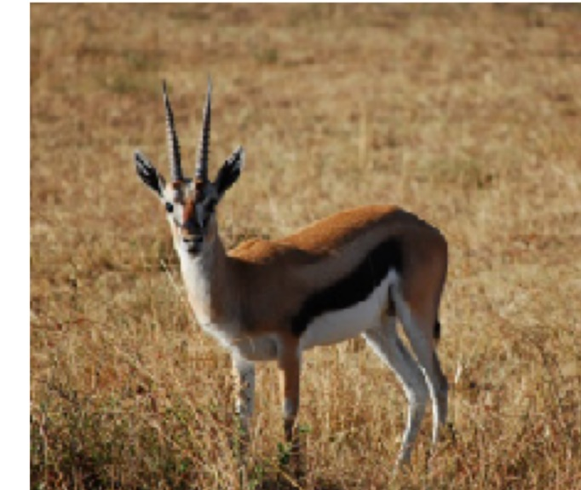
ALGORITHM :
Adversarial attacks algorithms
Adversarial Attack is a method of lightly modifying the original input image by adding adversarial perturbations in such a way that these alterations are almost unnoticeable to the human eye leading to misclassification and incorrect results.
For the image data model, we have implemented three prime adversarial attack algorithms such as FGSM, PGD and BIM
Initially the image of a gazelle is considered
Department of Computer Science & Engineering, DSCE

Slide 23
DenseNet is a type of convolutional neural network that utilises dense connections between layers. This means that each layer receives the outputs of all previous layers as input.
DenseNets have been shown to be effective for a variety of image classification tasks, including CIFAR-10, ImageNet, and MNIST.
When the input image is given to a DenseNet model,
Prediction: gazelle - confidence 1.00
Fast Gradient Method
It consisted of adding a linear amount of undetectable noise to a picture to falsely cause a model to identify it.
The result is an output image that, according to the human eye, looks identical to the original, but makes the neural network make an incorrect prediction
FGSM works by perturbing the input data by a small amount in the direction of the gradient of the loss function with respect to the input, causing the model to misclassify the perturbed examples.
When FGSM attack is performed,
Prediction: impala, Aepyceros melampus - confidence 0.63
Department of Computer Science & Engineering, DSCE

Slide 24
Project Gradient Method
It iteratively updates inputs based on the gradients of a loss function
The PGD algorithm starts with an initial input, which is typically a legitimate example from the dataset.
It then iteratively applies small perturbations to the input to craft an adversarial example.
The perturbations are generated by calculating the gradient of the loss function with respect to the input and then taking a step in the direction that maximizes the loss.
When PGD attack is performed,
Prediction: impala, Aepyceros melampus - confidence 0.92
Basic Iterative Method
BIM is an extension of the Fast Gradient Sign Method (FGSM) and the Projected Gradient Descent (PGD) attack techniques.
The BIM algorithm starts with an initial input sample, typically a clean data point from the dataset.
It then iteratively applies small perturbations to the input sample in the direction that maximizes the model's loss.
When BIM attack is performed,
Prediction: impala, Aepyceros melampus - confidence 1.00
Department of Computer Science & Engineering, DSCE

Slide 25
Defense Mechanisms
Defense mechanisms against adversarial attacks are the techniques and strategies employed to protect models or systems from the impact of malicious manipulations and adversarial inputs. These mechanisms aim to enhance the robustness, reliability, and security of models when faced with attempts to deceive or exploit their vulnerabilities.
In the context of image and text data models, defense mechanisms against adversarial attacks involve implementing measures to detect, mitigate, or counteract the effects of adversarial manipulations in the image and text inputs.
Department of Computer Science & Engineering, DSCE

Slide 26
The defense mechanisms employed to provide protection against the adversarial attacks performed on the image data model are spatial smoothing, gaussian augmentation, feature squeezing
Spatial smoothing
Spatial smoothing is a technique used in adversarial defense to increase the robustness of a deep learning model against adversarial attacks.
It aims to reduce the impact of adversarial perturbations by applying a smoothing operation to the input data.
The spatial smoothing algorithm aims to make the model more robust to adversarial attacks by filtering out high-frequency noise or perturbations that may be introduced by adversarial examples.
When Spatial Smoothing is applied as a defense mechanism
Prediction: gazelle, confidence - 0.90
Department of Computer Science & Engineering, DSCE

Slide 27
Gaussian Augmentation
Gaussian Augmentation is a technique used in adversarial defense to improve the robustness of machine learning models against adversarial attacks.
The idea behind Gaussian Augmentation is to add random noise to the input data during the training process, which makes the model more resistant to small perturbations in the input
When Gaussian Augmentation is applied as a defense mechanism,
Prediction: gazelle, confidence - 0.89
Feature squeezing
Feature squeezing is an adversarial defense technique that reduces the search space for an attacker by altering the input features of a machine learning model.
The basic idea is to map multiple similar inputs into the same output, making it more difficult for an attacker to generate a successful attack
When Feature squeezing is applied as a defense mechanism,
Prediction: gazelle, confidence - 0.79
Department of Computer Science & Engineering, DSCE

Slide 28
Adversarial attack algorithms for the text data model
We have implemented three prime adversarial attack algorithms such as word perbutation, PWWS attack and Text Prompt attack algorithms
Firstly we have considered DistilBERT model.
DistilBERT is a distilled version of the BERT model.BERT is a bidirectional model, which means that it can process text in both directions, from left to right and from right to left. This makes BERT more powerful than previous language models, which could only process text in one direction. It has 40% less parameters than BERT base, runs 60% faster while preserving over 95% of BERT's performance. DistilBERT is a small, fast, cheap and light Transformer model trained by distilling BERT base
Word Pertubation
It is used in adversarial attacks on text data models to replace words in the input text with alternative words.
It generally substitutes one or two words, to change the sentiment of the text
When Word Pertubation attack is performed,
Positive (99%) --> Negative (95%)
consistently clever and suspenseful .
consistently malin and enigmatic .
Example
SYSTEM DIAGRAM / DESIGN :
In the above example we have lightly modified the original input image by adding adversarial perturbations in such a way that these alterations are almost unnoticeable to the human eye but leads to misclassification of the images.
Initially the model predicted the image as “Boat”, but when adversarial perturbations are introduced, it predicts the same image as “Ipod”
Department of Computer Science & Engineering, DSCE
Department of Computer Science & Engineering, DSCE
Department of Computer Science & Engineering, DSCE

Slide 29
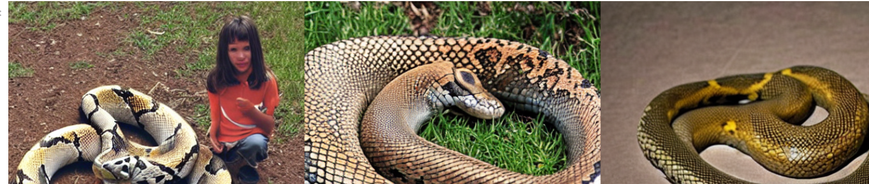
We have then considered the CLIPText model.
CLIPText model has been trained on a vast amount of textual and visual data and is used for Text-to-image generation.
Text Prompt Attack
Text prompt attack refers to a technique used to manipulate the output of language models by crafting specific textual prompts.
It involves strategically constructing input text that can influence the model's responses in unintended or undesirable ways.
When Text Prompt Attack is performed for an input of “a snake and a young man”,
greedy_prompt: a snake and a young man U6APX
genetic_prompt: a snake and a young man Q9<X@
Example
SYSTEM DIAGRAM / DESIGN :
In the above example we have lightly modified the original input image by adding adversarial perturbations in such a way that these alterations are almost unnoticeable to the human eye but leads to misclassification of the images.
Initially the model predicted the image as “Boat”, but when adversarial perturbations are introduced, it predicts the same image as “Ipod”
Department of Computer Science & Engineering, DSCE
Department of Computer Science & Engineering, DSCE
Department of Computer Science & Engineering, DSCE

Slide 30
We have then considered OpenAttack, which is an open-source Python-based textual adversarial attack toolkit. It handles the whole process of textual adversarial attacking, including preprocessing text, accessing the victim model, generating adversarial examples and evaluation.
PWWS (Projected Weighted-Wasserstein) Attack
In a PWWS attack, the attacker strategically selects words in the input text and substitutes them with alternative words that have similar semantic meaning.
The goal is to craft these substitutions in a way that the modified text appears benign or legitimate to a human observer, while causing the targeted model to produce incorrect or undesirable output
When PWWS Attack attack is performed,
Attack success rate: 90.831608%
Example
SYSTEM DIAGRAM / DESIGN :
In the above example we have lightly modified the original input image by adding adversarial perturbations in such a way that these alterations are almost unnoticeable to the human eye but leads to misclassification of the images.
Initially the model predicted the image as “Boat”, but when adversarial perturbations are introduced, it predicts the same image as “Ipod”
Department of Computer Science & Engineering, DSCE
Department of Computer Science & Engineering, DSCE
Department of Computer Science & Engineering, DSCE

Slide 31
The defense mechanisms employed to provide protection against the adversarial attacks performed on the text data model adversarial training
Adversarial Training
Adversarial training is a defense mechanism used to enhance the robustness of machine learning models against adversarial attacks, specifically in the context of text data models.
The primary idea behind adversarial training is to expose the model to adversarial examples during the training process.
Adversarial examples are carefully crafted inputs that are designed to deceive the model and cause it to make incorrect predictions.
By training the model on a mixture of clean and adversarial examples, the model learns to better understand and differentiate between normal and adversarial inputs.
When Adversarial Training is applied as a defense mechanism
Attack success rate: 81.208778%
Department of Computer Science & Engineering, DSCE

Slide 32
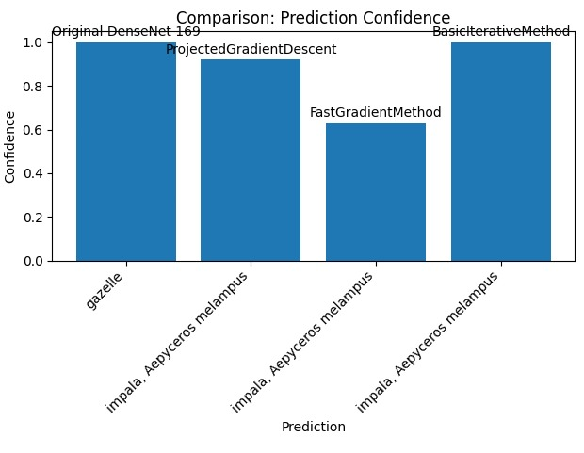
Result :
Department of Computer Science & Engineering, DSCE

Slide 33
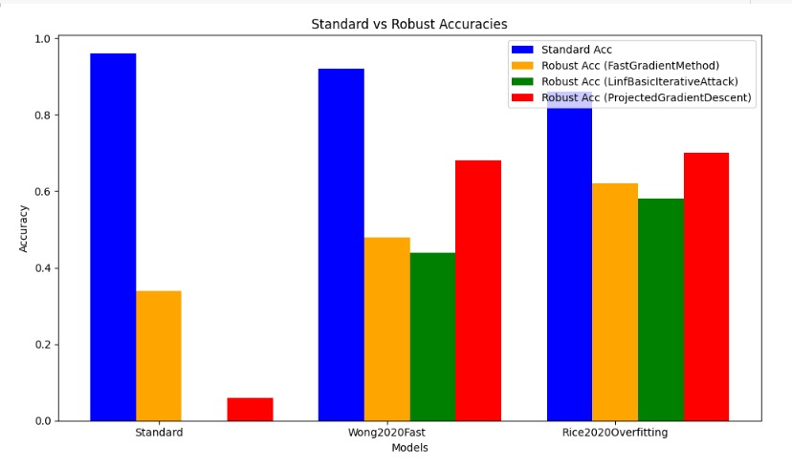
Department of Computer Science & Engineering, DSCE

Slide 34
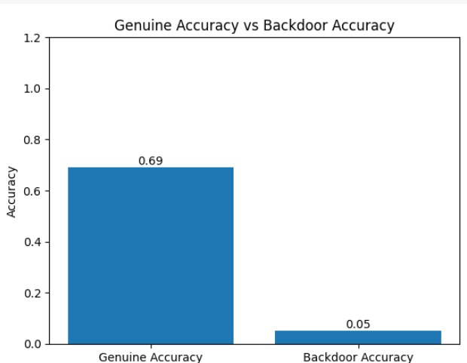
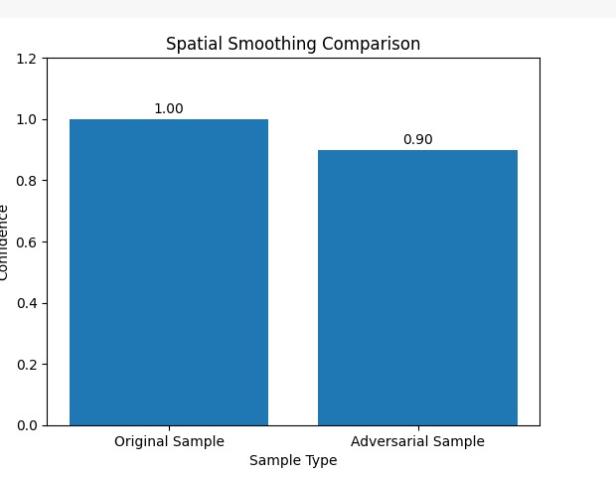
Department of Computer Science & Engineering, DSCE

Slide 35
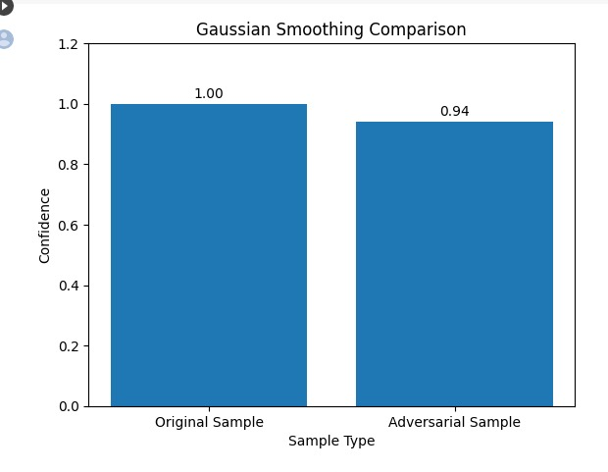
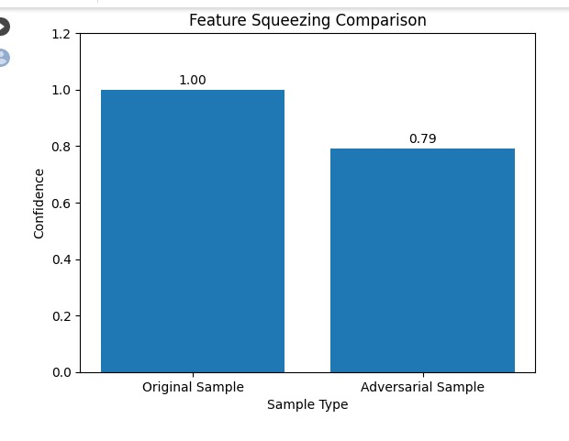
Department of Computer Science & Engineering, DSCE

Slide 36
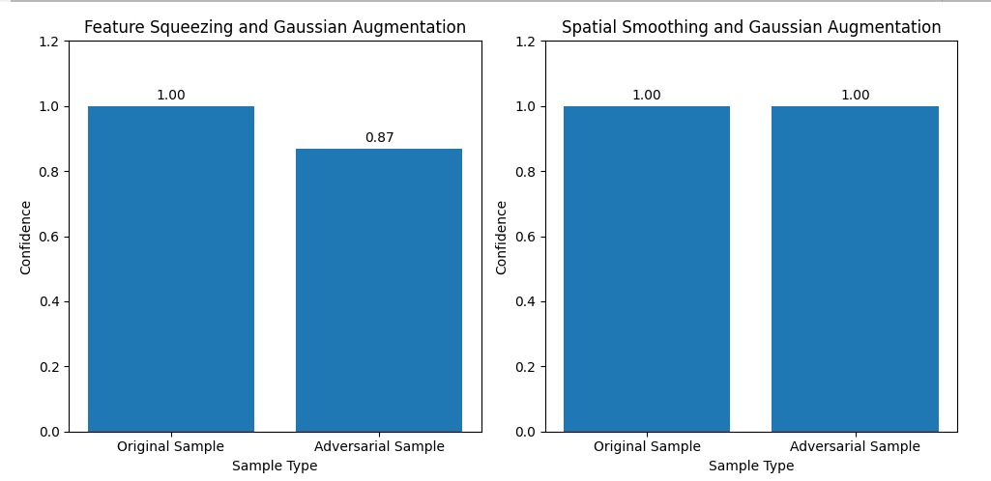
Department of Computer Science & Engineering, DSCE

Slide 37
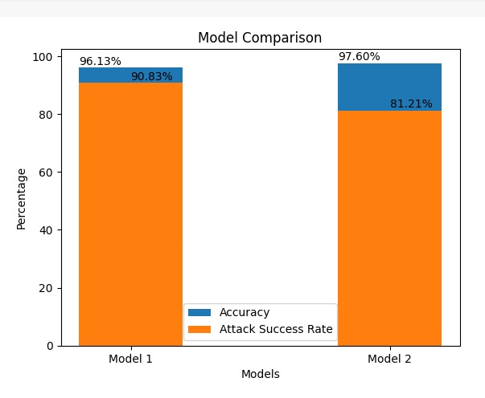
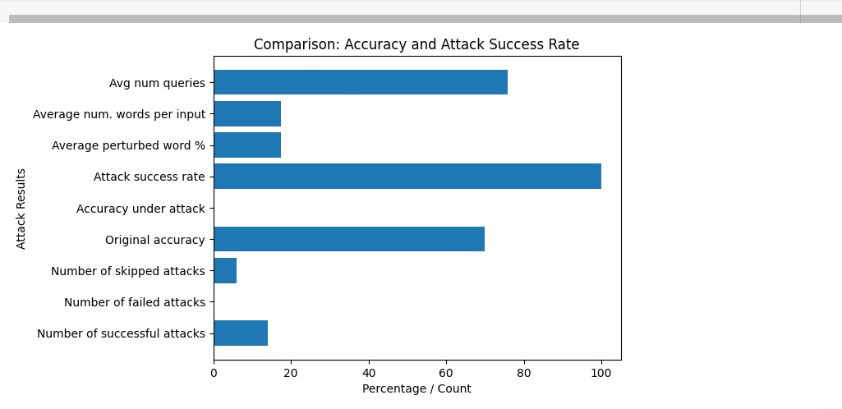
Department of Computer Science & Engineering, DSCE

Slide 38
Conclusion
Adversarial attacks and defenses in the context of image and text have emerged as significant challenges in the field of deep learning.Adversarial attacks refer to the deliberate manipulation of input data to deceive machine learning models, while adversarial defenses aim to mitigate the impact of such attacks.
In the domain of image-based adversarial attacks, researchers have developed various techniques such as FGSM, BIM, PGD to generate adversarial examples that can fool state-of-the-art deep neural networks.
To counter these attacks, researchers have proposed several defense mechanisms, including gaussian augmentation, spatial smoothing, feature squeezing techniques to remove or reduce the adversarial perturbations, thus making the models more robust and secure
Similarly, in the domain of text-based adversarial attacks, techniques such as word permutation, word addition, word replacement, PWWS attack and Text prompt attacks have been employed to craft adversarial examples that can fool natural language processing models
Department of Computer Science & Engineering, DSCE

Slide 39
Adversarial attacks and defenses in the context of image and text have emerged as significant challenges in the field of deep learning. Adversarial attacks refer to the deliberate manipulation of input data to deceive machine learning models, while adversarial defenses aim to mitigate the impact of such attacks.
To defend against text-based attacks, researchers have proposed techniques such as Adversarial training which involves augmenting the training data with adversarial examples, enabling the model to learn to be more robust to adversarial attacks and reducing vulnerability to attacks.
The impact of adversarial attacks and defenses have real-world implications in applications such as malware classifier, face recognition model, captcha model, twitter sentiment based stock price prediction model
In conclusion, the study of adversarial attacks and defenses in image and text is a vital area of research, highlighting the vulnerabilities of machine learning models and the need for robust defenses.
Further exploration and development of innovative techniques are essential to ensure the security and reliability of AI systems in an increasingly interconnected and data driven world
Department of Computer Science & Engineering, DSCE

Slide 40
References
Bhavana Kumbar, Shashidhara B. Vyakaranal, Ankita Mane, Meena S. M, Uday Kulkarni, Varsha Chalageri, Sunil V. Gurlahosur, A Comparative Study on Adversarial Attacks and Defense Mechanisms
Yucong Lai and Yifeng Wang, Adversarial Attacks Technology in Deep Learning Models
Muttoni, A. Adversarial Attacks for the Deep Learning model using Efficient Gradient Integrated Attacking algorithm
Jingbo Hao∗, Yang Tao, Adversarial attacks on deep learning models in smart grids
Tian, Jiwei; Wang, Buhong; Li, Jing; Konstantinou, Charalambos, Adversarial attack and defense methods for neural network based state estimation in smart grid
Ninghao Liu, Mengnan Du, Ruocheng Guo, Huan Liu, Xia Hu, Adversarial Attacks and Defenses: An Interpretation Perspective with a Flower to Retrieve the Tower
Rulin Shao, Zhouxing Shi, Jinfeng Yi, Pin-Yu Chen, Cho-Jui Hsieh, Robust Text CAPTCHAs Using Adversarial Examples
Nicolas Muller, Daniel Kowatsch, Konstantin Bottinger, Data Poisoning Attacks on Regression Learning and Corresponding Defenses
Department of Computer Science & Engineering, DSCE

Slide 41
Co-Guide Meet Details
10/1/23 - first co-guide meet
Remarks by the co-guide : Looks good so far. Come up with design for the project.
30/1/23 - second co-guide meet
Remarks by the co-guide : Looks good so far. Start with the implementation for the image data model.
11/4/23 - third co-guide meet
Remarks by the co-guide : Looks good so far. Start with the implementation for the text data model.
Department of Computer Science & Engineering, DSCE

Slide 42

PROJECT TOOL SNAPSHOT
Department of Computer Science & Engineering, DSCE

Slide 43

Department of Computer Science & Engineering, DSCE

Slide 44
cv
Batch No : 68
Team Member 1 : Gaurav Sarkar 1DS19CS715 Contribution : Implemented adversarial attacks and defense mechanisms on image data model | Team Member 2 : Durgesh Nandini M 1DS19CS711 Contribution : Implemented adversarial attacks and defense mechanisms on image data model
Team Member 3 : GaganDeep 1DS19CS714 Contribution : Implemented adversarial attacks and defense mechanisms on text data model | Team Member 4 : Faizan khurshid 1DS19CS713 Contribution : Implemented adversarial attacks and defense mechanisms on text data model
Department of Computer Science & Engineering, DSCE

